Slide 1
Redefining Expertise: Engaging Older Adults as Research Partners

Slide 2
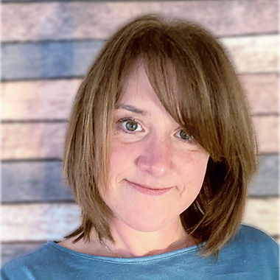
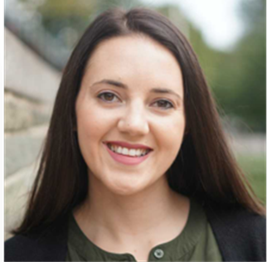
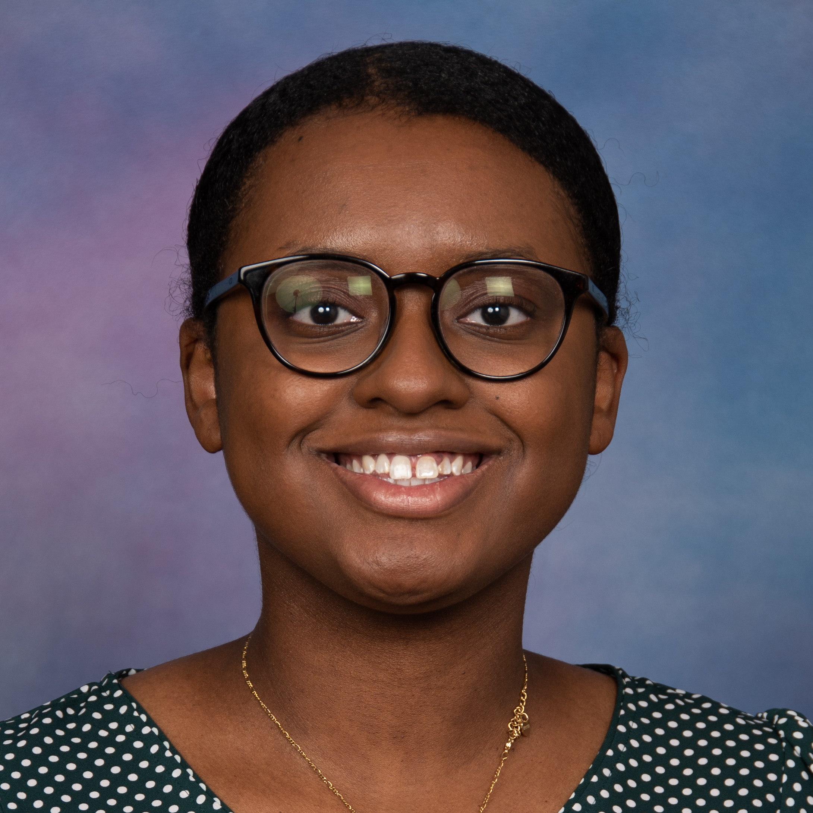
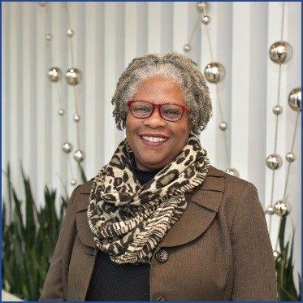
Today’s Speakers
Erin McGaffigan, PhD
Principal, Collective Insight
Vanessa Rorai Community Outreach Specialist, Healthier Black Elders Center
Brittany Dowe, MPH Director of the Office of Cancer Health Equity and Community Engagement (OCHECE) at Karmanos Cancer Institute
Voncile Brown-Miller Manager of Community Engagement, OCHECE at Karmanos Cancer Institute

Slide 3
Agenda
Background
Defining Engaged Research
Funders Funding Engaged Research
The PCORI-Funded Aging PCOR Learning Collaborative
The NIH Funded Healthier Black Elders Center
Engagement in Action
The Office of Cancer Health Equity and Community Engagement (OCHECE) at Karmanos Cancer Institute and Wayne State University

Slide 4
About Us
Notes:
This seminar series is a part of our Aging PCOR Learning Collaborative, a project funded by a Eugene Washington PCORI Engagement Award (19514-LTSS). The Learning Collaborative works with Researchers, Funders, and Gerontology programs to share the benefits and methods of Patient-Centered Outcomes Research (PCOR). Our goal is to get more researchers to engage older adults in the design of research, not just as research subjects.
As of today, participants will be:
-from our Gerontology PhD program, 9 first-year, 3 second-year, and 10 third-year students
-from UMass Medical: 3 PhD students, 1 postdoc (I think – in any case, 4 from UMMS)
->so total of 26 participants

Slide 5
Engaged Research
What It Is
What It Is NOT
Engaging those with Lived Experience as Partners, Not Research Subjects
Engaging Across the Research Phases
Being Flexible
Being Accessible
Just Qualitative Research
Focus Groups or Interviews as Data Collection Methods
Presenting Your Findings After Your Research
Engaging Then Doing What You Originally Wanted

Slide 6
VARIOUS TERMS, HISTORIES, METHODS, FUNDERS…
Community-Based Participatory Research
Patient-Centered Outcomes Research
Stakeholder/ User/ Community Engagement
Public Participant Involvement Engagement
Notes:
“Community-based participatory research (CBPR) is an approach to research that involves collective, reflective and systematic inquiry in which researchers and community stakeholders engage as equal partners in all steps of the research process with the goals of educating, improving practice or bringing about social change [1,2,3]. At its core, CBPR questions the power relationships that are inherently embedded in Western knowledge production, advocates for power to be shared between the researcher and the researched, acknowledges the legitimacy of experiential knowledge, and focuses on research aimed at improving situations and practices [3]. This approach to research is recognized as particularly useful when working with populations that experience marginalization – as is the case for some Indigenous communities—because it supports the establishment of respectful relationships with these groups, and the sharing of control over individual and group health and social conditions [3, 4].” Understanding community-based participatory research through a social movement framework: a case study of the Kahnawake Schools Diabetes Prevention Project | BMC Public Health | Full Text (biomedcentral.com)
“Major research funding bodies are, to varying degrees, encouraging of PPIE. In the United Kingdom, for example, the National Institute for Health Research (NIHR)—the major funding body for applied health research—has taken a notably forthright position, requiring researchers applying for funding to “describe how they have involved the public in the design and planning of their study as well as their plans for further involvement throughout the research, including plans for evaluating impact” (National Institute for Health Research, n.d. [4]). In Australia, the National Health and Medical Research Council encourages researchers to involve patients in all stages of the research process (NHMRC, 2016).” Reporting of patient and public involvement and engagement (PPIE) in clinical trials published in nursing science journals: a descriptive study | Research Involvement and Engagement | Full Text (biomedcentral.com)

Slide 7
What Engaged Research Looks like
Designing research questions
Developing research materials
Choosing data collection strategies and collecting data
Interpreting findings
Writing reports and journal articles
Presenting results and facilitating dissemination strategies
People with lived experience inform research design, implementation, and dissemination:
Co-PI models
Advisory Boards
Community Forums
A Mix Of Methods

Slide 8
FUNDERS PRIORITIZING ENGAGED RESEARCH
Patient-Centered Outcomes Research Institute (PCORI)
National Institutes of Health (NIH)

Slide 9
Pcori funded projects – older adults
Most Studied Populations
Most Studied Conditions
Top conditions studied that affect older adults; projects may address more than one condition. As of August 2022

Slide 10
The aging pcor learning collaborative - Background
While many older adults are eager to engage in research, researchers’ interest in and readiness for engagement is far less evident.
Traditional research paradigm assumes researchers are the primary experts.
Many aging-focused students and researchers are missing the knowledge and skills required to apply engaged research methods.
Few research funders include engagement in their funding portfolio or requirements.

Slide 11
The Aging PCOR Learning Collaborative - Objective
Objective
Project Aims
Increase the willingness and readiness of researchers to implement PCOR (engaged research) with older adults and their caregivers, including those from underserved populations
Educate stakeholders on benefits and strategies of engaged research
Train more aging-focused researchers and broader partners to apply engaged research skills
Obtain buy-in from academic leaders and funders to include engagement in their research curricula and funding portfolios

Slide 12
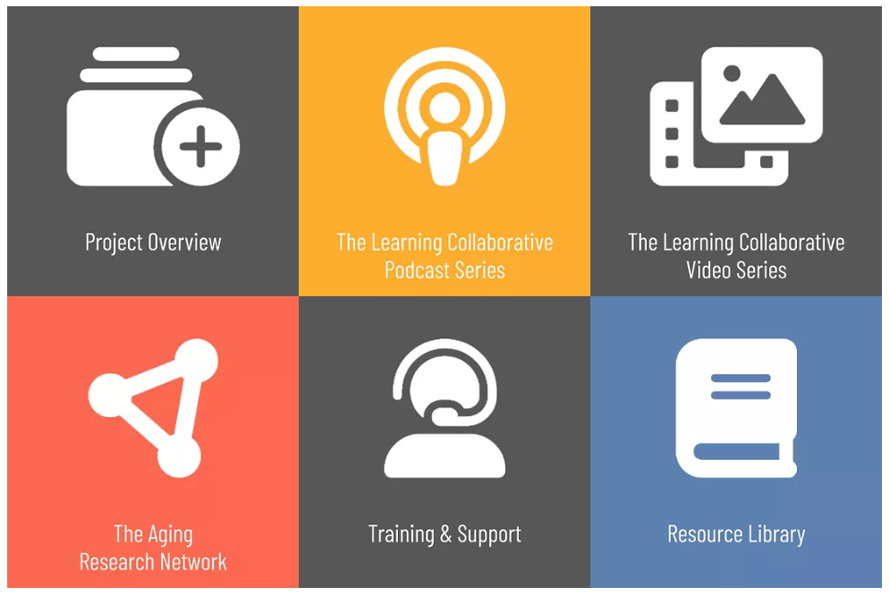
For More Information, Visit Our Webpage
and Join The Aging Research Network!

Slide 13
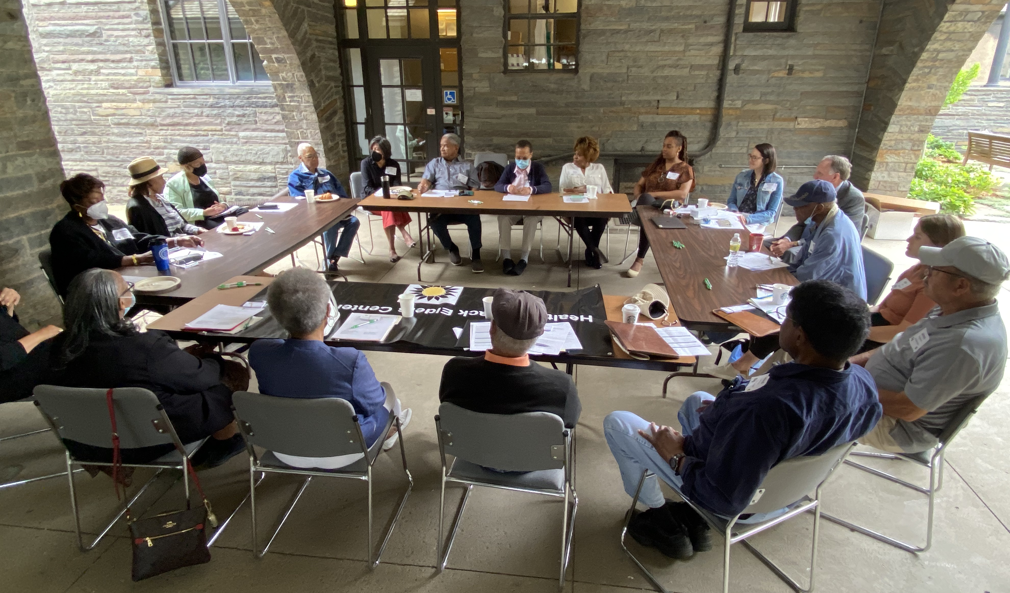
Who We Are
NIH Funded to target and reduce health disparities through research and education
Research registry of 1100+ older African American adults
Community events
Community Advisory Board

Slide 14
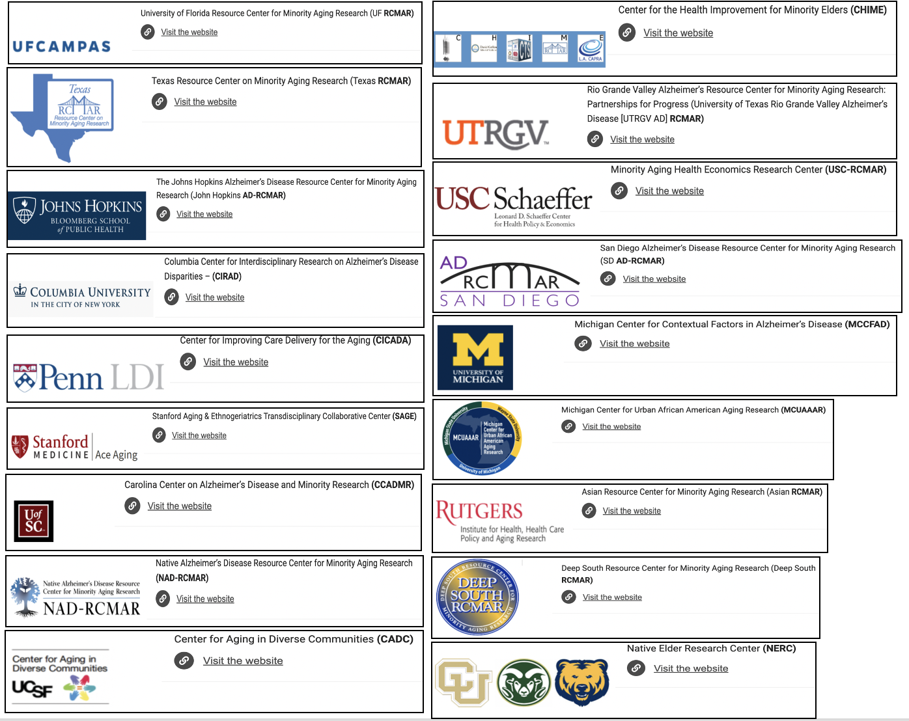
RCMAR CENTERS
There are 18 funded RCMAR Centers, several of which involve multiple sites.
https://rcmar.org/about-us/our-centers/

Slide 15
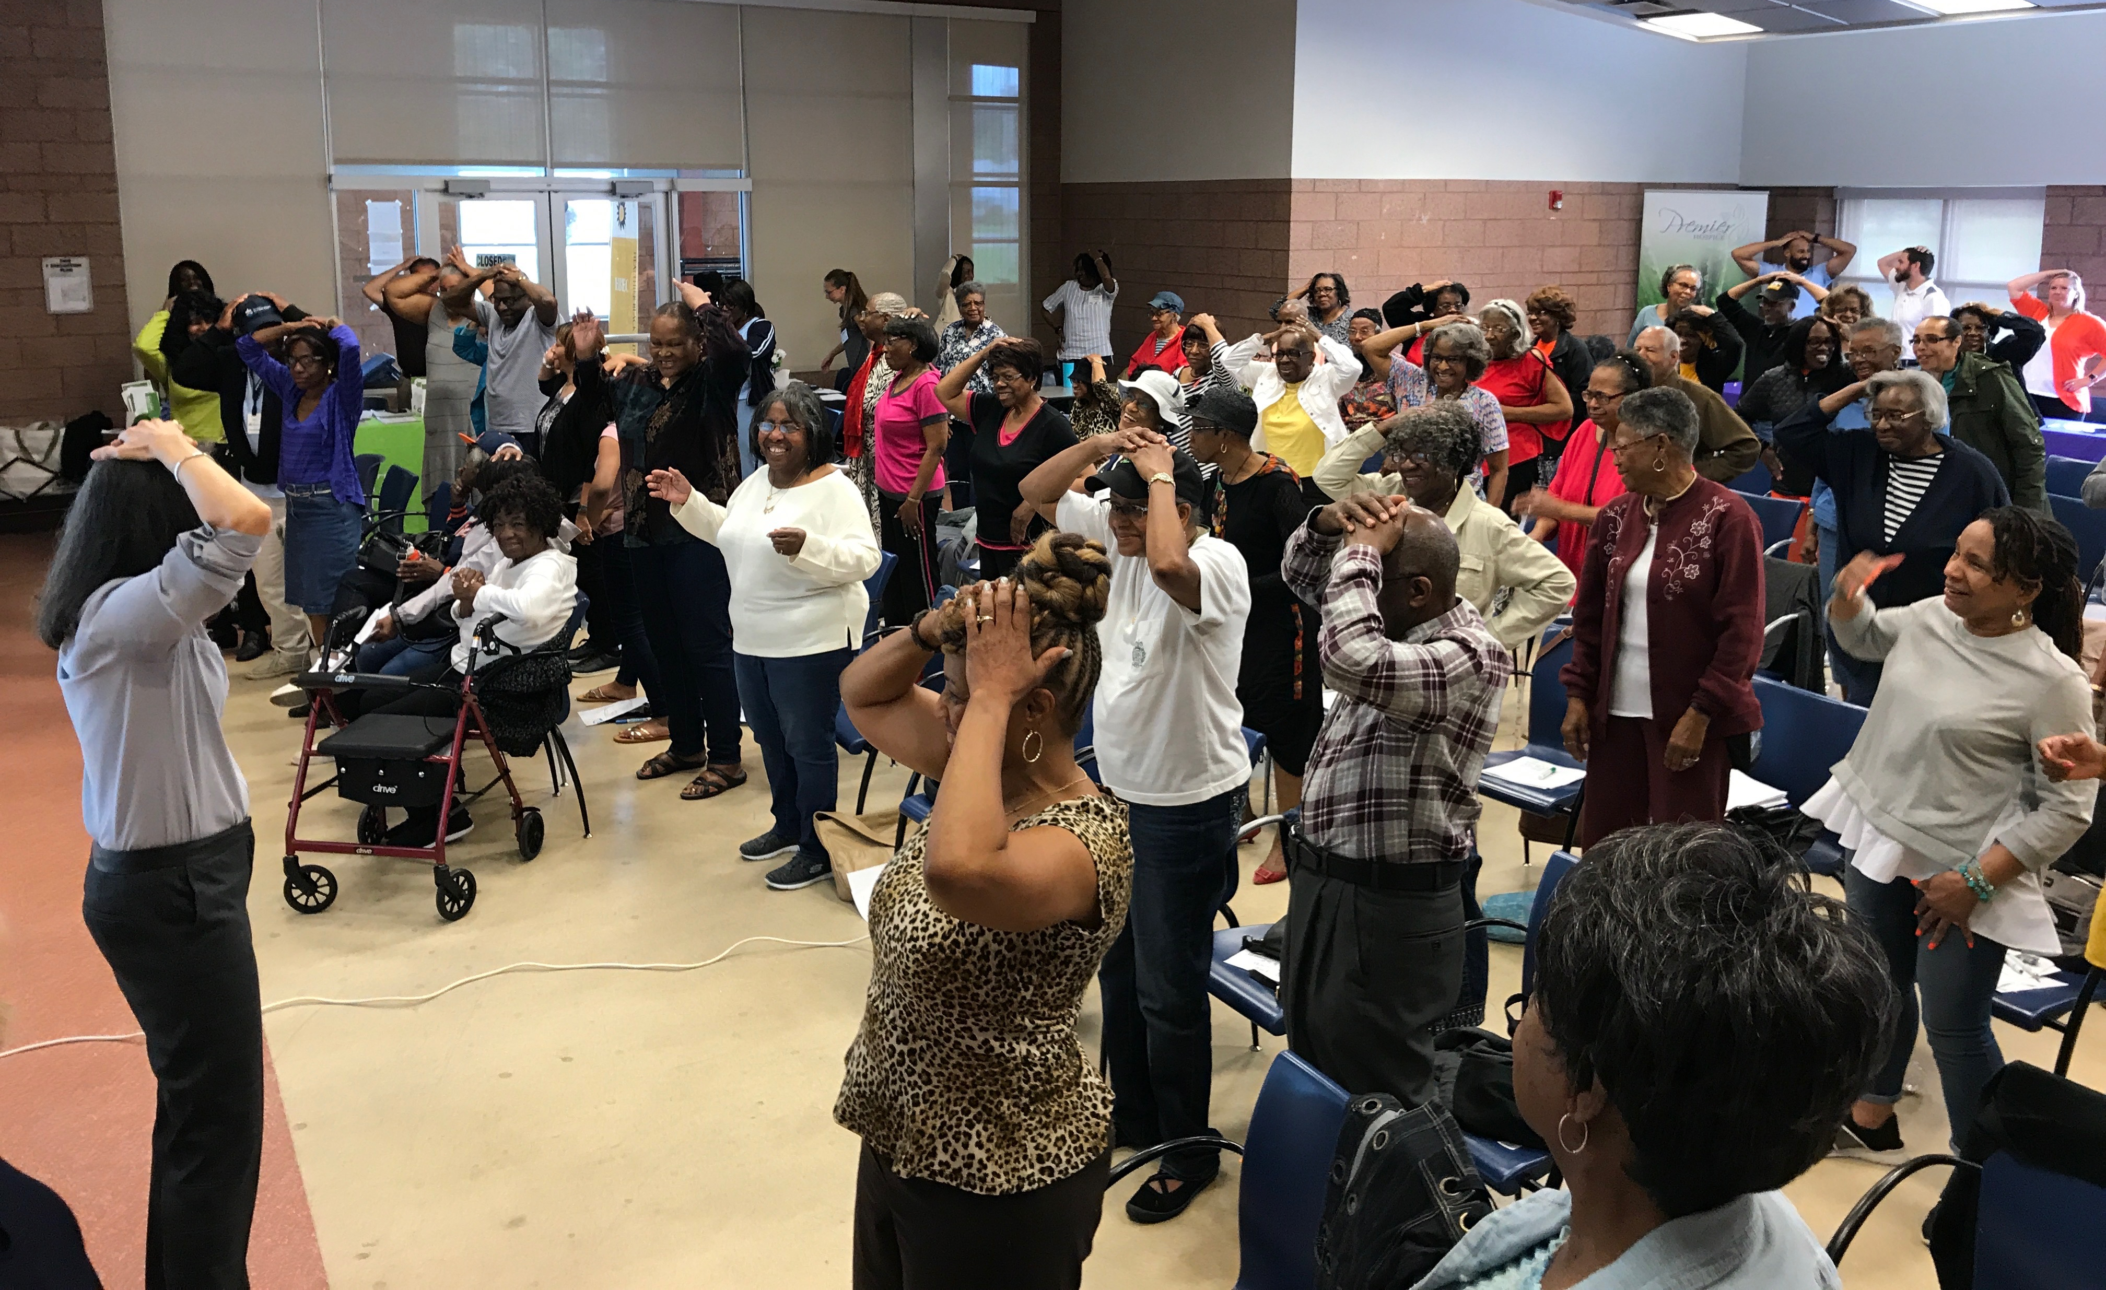
Benefits to Engaging Older Adults in Research
Leads to meaningful/relevant research topics and programming
Party Line for loneliness/isolation
Critical Crossroads for social determinants of health
Lunch & Learn topics
Consultancy program (contribute to planning and dissemination of results)
Can support overcoming challenges/issues of recruitment
The WALLET study

Slide 16
Links to More Information
RCMAR Centers: https://www.nia.nih.gov/research/dbsr/resource-centers-minority-aging-research-rcmar
MCUAAAR website: https://mcuaaar.org/
PRP information & forms: https://mcuaaar.org/cores/community-liaison-and-recruitment-core/participant-resource-pool/
PRP Survey: https://engageus.ripplescience.com/survey/SN4DSKBzsh2EPds3P/Ywt3BoRwrzJdreoMx/form
HBEC Lunch & Learn Recordings: https://mcuaaar.org/resources/videos/hbec/
HBEC Newsletter: https://mcuaaar.org/resources/newsletters/hbec-newsletters/
EngageUs website: https://engageus.org/

Slide 17
Contact Us!
Dr. Tam Perry
School of Social Work Institute of Gerontology
Wayne State University, Detroit MI
teperry@wayne.edu
Vanessa Rorai
Institute of Gerontology, Wayne State University, Detroit MI
vrorai@wayne.edu 313-664-2604
HBEC Office
Institute of Gerontology, Wayne State University
87 E. Ferry St., Detroit MI 48202
313-664-2616

Slide 18
Building a Community-Academic Partnership: Michigan Cancer HealthLink and the Cancer Action Councils
Brittany Dowe, MPH and
Voncile Brown-Miller

Slide 19
Agenda
Introduction to Karmanos Cancer Institute and Office of Cancer Health Equity and Community Engagement (OCHECE)
HealthLink background
Cancer Action Councils Structure and Achievements
Cancer Action Council Partnership Evaluation

Slide 20
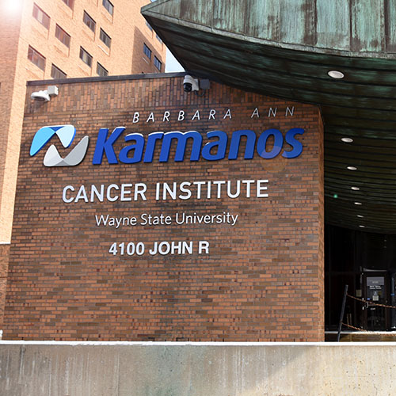
Karmanos Cancer Institute (KCI)
KCI is a National Cancer Institute (NCI)-designated comprehensive cancer center
Only 53 in the country
Demonstrate scientific leadership, in basic, clinical, and/or population science
Funded by NCI Cancer Center Support Grant (CCSG) through WSU and reviewed every 5 years
PAR-20-043: Cancer Center Support Grants (CCSGs) for NCI-designated Cancer Centers (P30)

Slide 21
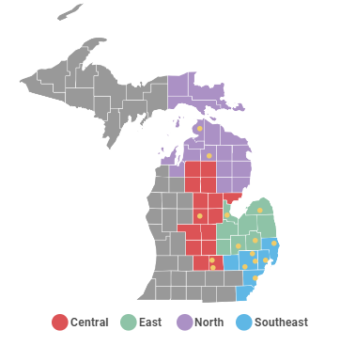
KCI catchment area
46 counties, 6.7M residents
KCI serves 31% of new cancer patients in this region (~12K) across 15 locations
Key characteristics
Largest city: Detroit, 78% African American, 35% below poverty level
~277K MENA residents in MI, 50% in Wayne County
~725,000 rural residents
MI: 4% Sexual and gender minorities (SGMs), among states with highest proportion of African American SGMs

Slide 22
Office of Cancer Health Equity & Community Engagement (OCHECE)
OCHECE has primary responsibility for Community Outreach and Engagement (COE)
OCHECE was established in 2017; Thompson became inaugural Associate Center Director for COE in 2018
Received the Michigan Cancer Consortium 2020 Spirit of Collaboration Award
Website: www.karmanos.org/karmanos/ office-of-community

Slide 23
The HealthLink model
A model of academic-community partnership and participatory research
HealthLink model initially guided a partnership between Queens Library, the American Cancer Society, Queens Cancer Center, and Albert Einstein College of Medicine (PI: Rapkin; R01CA119991)
Developed Cancer Action Councils (CACs) in 20 Queens Library locations
Community members and researchers collaborate in an iterative process of
Problem definition
Problem solving
Evaluation
Building research and programmatic skills
Developing tools
Mobilizing new resources,
Broadening and deepening relationships

Slide 24
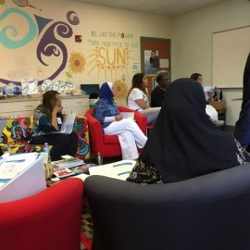
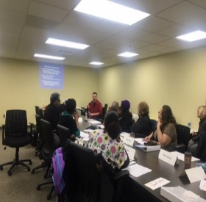
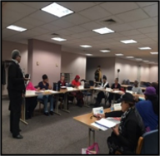
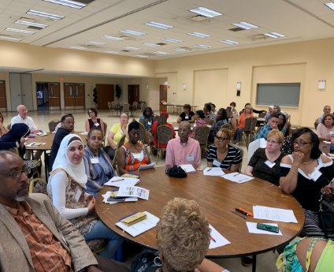
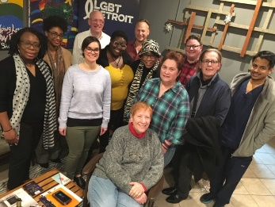
Michigan Cancer HealthLink
Cancer Action Councils (CACs)
Established in 2016, CACs are groups of survivors, caregivers, and advocates who represent diverse populations and geographic areas
OCHECE currently supports 11 CACs with 91 members across all groups
2017 Michigan Cancer Consortium Spirit of Collaboration Honoree
ACCESS – Dearborn
Western Wayne Family Health Center - Inkster
Conner Creek
LGBT-Detroit
All-Cancer Action Council meeting,
Detroit, June 2019
Notes:
In 2016 the first CAC were established Conner Creek, Western Wayne and KCI, In 2017 ACCESS and LGBT Detroit came on board. 2018- Oakland –Genesee- and Macomb County were established. 2020- Black Men's and in 2021 Young survivor, and Rural and Genomic Research Action Council.
These groups come together once a month for 2 hours 9 months our of the year.
In 2017 CAC won the spirit of collaboration Award from the Michigan Cancer Consortium
Reorganize slide

Slide 25
Michigan Cancer HealthLink
Cancer Action Councils (CACs)
CAC | Host site/partner organization
1. Conner Creek | Voices of Detroit Initiative (Dissolved)
2. Western Wayne | Western Wayne Family Health Center (Inkster)
3. ACCESS/Dearborn | ACCESS (Dearborn)
4. LGBTQ | LGBT Detroit
5. Oakland County | American Cancer Society (Southfield)
6. Macomb County | Macomb County Health Department (Mt. Clemens)
7. Genesee County | RL Jones Community Outreach Center (Burton/Flint)
8. Black Men’s | Tabernacle Missionary Baptist Church (Detroit)
9. Young Survivor | Gilda’s Club (metro Detroit)
10. Rural Michigan | United Way of Isabella & Gratiot Counties
11. Genomic Research Action Council (GRAC) | Faith-Based Genetic Research Insititute (Detroit)
Notes:
As you can see we are covering many communities and specialty area representing a significate portion of our catchment area.
From 2016 through 2021. We have established 11 Cancer Action Council Each has two facilitators, and meet for 2 hours monthly. I would like to acknowledge the fact that all the CAC met throughout the pandemic and several were established during the COVID. We have not missed a beat.
I just want to recognize some of our partners, Lisa Rutledge, Western Wayne Family Center, Mona Makey, ACCESS, Ziar Kweneba, (a- qib -ben- na) LGBT Detroit
Megan Landry, American Cancer Society, Katrina, Studvent, Rural- Annie Sanders- United Way of Gratiot and Issabella Counties.

Slide 26
Funding supporting CAC creation
2016: "Preparing Detroit Communities to Advance Cancer Research." Funder: Patient-Centered Outcomes Research Institute (PCORI), Eugene Washington Community Engagement Award (2972-WSUSM)
2016: "Detroit HealthLink for Equity in Cancer Care: Expanding to Arab American Communities." Funder: DMC (Detroit Medical Center) Foundation Health Education and Community Benefit Grant
2017: "Partnering with Sexual and Gender Minority Communities to Address Cancer Disparities in Detroit." Funder: Patient-Centered Outcomes Research Institute (PCORI) Eugene Washington Engagement Award (6252-WSU)
2019: “Program for Breast Cancer in Young Women.” Funder: Michigan Department of Health and Human Services/CDC
2019: "Best Practices to Engage Black Men in the Development of a Cancer Health Equity Research Agenda." Funder: Patient-Centered Outcomes Research Institute (PCORI) Eugene Washington Engagement Award (423817-WSU)
2020: "Building Capacity in Detroit’s African American Faith Community to Advance Genomic Research." Funder: Patient-Centered Outcomes Research Institute (PCORI) Eugene Washington Engagement Award (20136-WSU)
Notes:
These are the grants that support our work.

Slide 27
Building Cancer Action Councils (CACs)
We first identified community-based organizations (CBOs) to host a CAC
Clearly outlined the organization’s role in a memorandum of understanding (MOU)
CBO is usually the meeting site
Useful to budget funds to cover the time of a CBO staff member for support
CBOs were instrumental in identifying and nominating potential CAC members in addition to other strategies

Slide 28
Identifying CAC members
Our team developed a selection process to ensure a good fit
Identified survivors, caregivers, advocates
Created an application that asked about demographics, commitment and availability, one’s experience with cancer, and other relevant community experiences.
Ensure candidates are prepared for discussion of sensitive topics
Applications gave insight into the potential make-up of the group.
After written or online application, candidate was interviewed by team members
Clearly outlined CAC members’ roles in Memorandum of Understandings (MOUs)

Slide 29
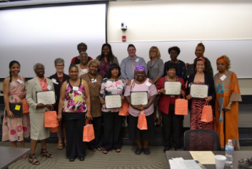
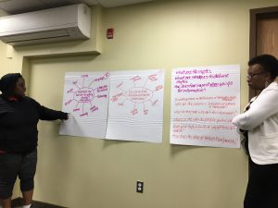
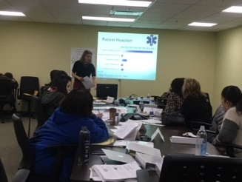
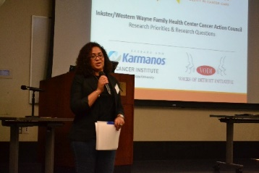
Identifying cancer research priorities through a community lens
Research capacity building
Concept mapping & question development
Building research relationships
Prioritization & dissemination
9 modules focused on building research capacity; focus on cancer, CER & PCOR; Building knowledge and skills necessary to become equal partners
Identification of cancer-related research needs by CAC; Concept mapping and brainstorming; Developing and refining research questions
Presentations & dialogues between cancer researchers and CACs; Facilitation of meetings & CAC and cancer researcher collaborations; Opportunities to gain research experience
Prioritization of community research needs by CAC members; Completion of formal report on research priorities; Community forums, research symposium and All-CAC meeting
Notes:
At least 2 HealthLink specialist/facilitators guide the group through these four large activities

Slide 30
KCI Building Your Capacity (BYC) Curriculum
Adapted the Tufts CTSI curriculum, “Building Your Capacity: Advancing Research through Community Engagement” (BYC)
Adapted for Michigan Cancer HealthLink for cancer prevention and control research
CAC members are required to complete the 9-module BYC curriculum which provides introductory research training
Provide participants with a basic understanding of the academic research process
Increase their overall level of confidence in engaging with academic researchers
Familiarize them with research terminology and concepts
Notes:
The BYC Curriculum provides participants with a basic understanding of the academic research process and familiarizes them with research terminology and concepts to increase their overall level of confidence in engaging with academic researchers.
The curriculum is delivered in 9 modules, typically one module per council meeting. It is intended to build community research capacity and is instrumental in preparing community members to develop and prioritize a cancer research agenda for their communities.

Slide 31
KCI BYC Curriculum: Research 101
9 modules
Introduction to Research and Evaluation
Research & Community-Academic Partnerships; Power & Politics
Developing Research Questions
Literature Review & Evaluating Information Sources
Research Design
Ethics & Institutional Review Boards
Qualitative Methods & Data Analysis/Quantitative Methods & Data Analysis
Proposal Writing & Grantsmanship
Policy and Advocacy

Slide 32
Evidence prioritization
Step 1: Identification of the mission, vision, and objectives for research
Continuum of cancer care supported discussions of broad objectives
Risk Assessment
Cancer Treatment
Survivorship
End-of-Life Care
Detection/
Diagnosis
Primary Prevention
(Concannon et al., 2014)

Slide 33
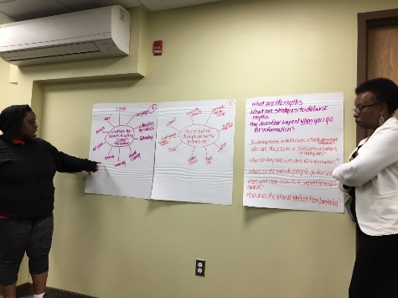
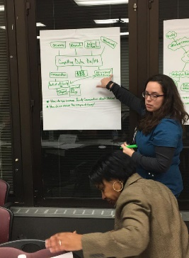
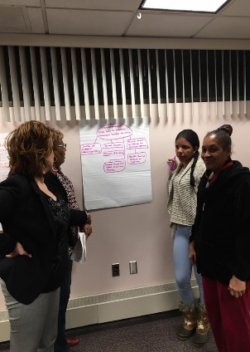
Evidence prioritization
Concept mapping
Steps 2 & 3: Identification and prioritization of research topics/questions
Concept mapping
Visual strategy for organizing and representing knowledge
Facilitates a group process for generating ideas
CAC members report that this is a favorite
activity
(Concannon et al., 2014)

Slide 34
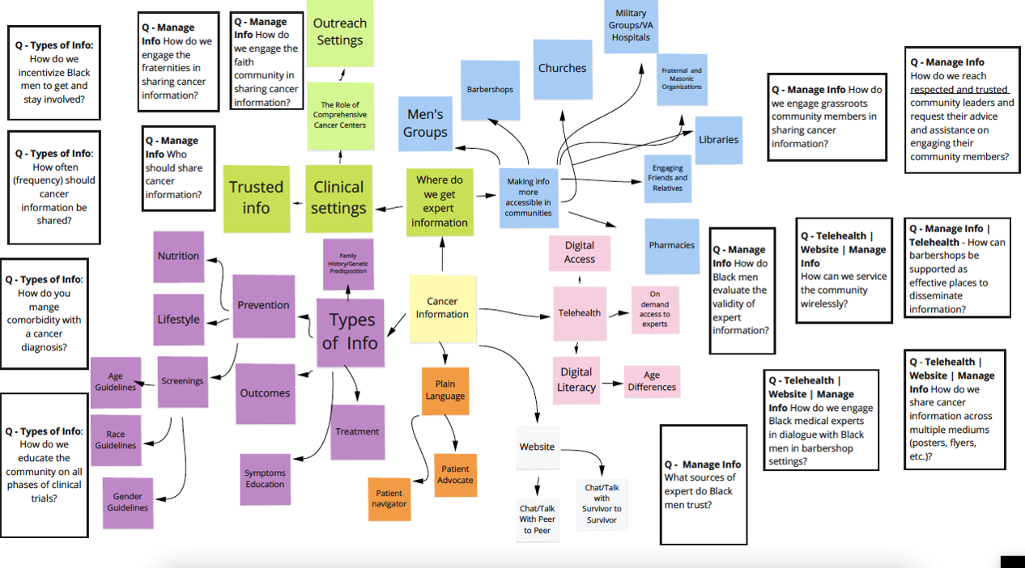
Concept map created with Miro: Black Men’s CAC

Slide 35
CAC research priorities: Examples
Conner Creek Priorities
Cancer patient navigation
Cancer caregiving
Cancer patients' psychological well-being.
Oakland County CAC Priorities
Cancer screening
Technology
Genetic risk communication with families/social networks
Black Men’s CAC Priorities
Cancer information
Financial Toxicity
Medical trust/mistrust
Link: https://www.karmanos.org/karmanos/cac-research-priorities-questions
Notes:
Bubbles – three examples
Access- Shame stigma around cancer along with mental health issues related to cancer survivorship
Conner Creek – They have developed a caregivers guide
YSCAC – has major concern about fertility preservation
These are profound and thoughtful cancer concerns.
PCORI funding -----> Priorities ----> Caregiving
LGBTQ
DMC foundation grant
Interviews
Paper

Slide 36
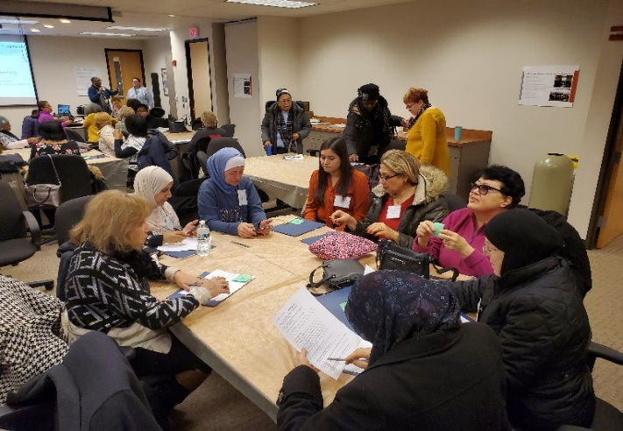
All-CAC meeting
All-CAC meetings started in June 2019
Hosted 8 All CAC meetings (3 in-person, 5 virtual)
All-CAC Big Idea 2019: Financial toxicity
Led to “Michigan Community Outreach to Address Financial Toxicity” (MI-COST)
All-CAC Big Idea 2023: Cancer caregiving
All-Cancer Action Council meeting
American Cancer Society Offices
Southfield, MI January 2020
Notes:
Insert all CAC meeting Pic
MI COST – Spell out grant name
- Aims of grant
Financial Toxicity is defined In medicine, a term used to describe problems a patient has related to the cost of medical care.
Describes the negative impact medical expenses can have on patients in terms of their health related quality of life, leading to negative mental and physical effects as well as, in some cases, bankruptcy, loss of job or income or even homelessness.
These issues can sometime cause delay of treatment or avoiding treatment altogether.
Over the past 3 years CACs' learned about how financial toxicity effect patients,
what has been already written about it. Evidence based information
- What CAC members, thought should be done about it. Using a logic model learning how to implement such a program.
Share Theresa Grant- CAC members will be working in partnership with Dr. Hastert as she implements the goals of the grant
.
Smaller

Slide 37
CAC research projects and partnerships
“ARISE: African American Resilience in Surviving Cancer” (NCI R01 CA232514, KCI/WSU MPIs: Thompson, Harper)
Participatory theoretical model building with a study-specific council with members from 4 CACs
“Reducing Cancer Health Disparities in Detroit” (P20CA262735, KCI/WSU MPIs: Schwartz, Heath)
CACs are supporting the Patient and Community Engagement Core on multi-study project related to responses to immunotherapy among African American cancer patients
“DISCO: A Patient Intervention to Reduce the Financial Burden of Cancer” (American Cancer Society Research Scholar Award, KCI/WSU PI: Hamel)
Formative work conducted with CACs
“Supporting Cancer Caregiving among LGBT Populations in Metropolitan Detroit” (DMC Foundation, KCI/WSU PI: Thompson)
Supported by LGBT CAC, which also submitted manuscript to Frontiers in Oncology in Feb. 2022: “Community-Driven Identification and Adaptation of a Cancer Caregiving Intervention for LGBTQIA Populations”
Notes:
Insert all CAC meeting Pic
MI COST – Spell out grant name
- Aims of grant
Financial Toxicity is defined In medicine, a term used to describe problems a patient has related to the cost of medical care.
Describes the negative impact medical expenses can have on patients in terms of their health related quality of life, leading to negative mental and physical effects as well as, in some cases, bankruptcy, loss of job or income or even homelessness.
These issues can sometime cause delay of treatment or avoiding treatment altogether.
Over the past 3 years CACs' learned about how financial toxicity effect patients,
what has been already written about it. Evidence based information
- What CAC members, thought should be done about it. Using a logic model learning how to implement such a program.
Share Theresa Grant- CAC members will be working in partnership with Dr. Hastert as she implements the goals of the grant
.
Smaller

Slide 38
Partnership evaluation 2022 (N=66)
Each year, CAC members complete a partnership evaluation assessing the HealthLink model and the CACs
Sense of involvement and belonging (6 items)
Individual influence (1 item)
Commitment (6 items)
Research interest and involvement (3 items)
Satisfaction with staff and the project (4 items)
Satisfaction with the CAC (4 items)

Slide 39
Research involvement
 | How likely are you to... | Extremely likely/ likely
1. | Get involved in other cancer research programs. | 93.9% (n=62)
2. | Seek out new research programs related to cancer. | 87.8% (n=58)
3. | Seek out other research-based programs that engage or involve community members. | 93.9% (n=62)

Slide 40
Satisfaction
 | How satisfied are you with the following... | Very satisfied/ satisfied
1. | The process used by the CAC to create research priorities and generate research questions. | 86.3% (n=57)
2. | The programs proposed to meet objectives. | 90.9% (n=60)
3. | The level of CAC member involvement with program activities. | 86.3% (n=57)
4. | Overall CAC functioning. | 87.8% (n=58)

Slide 41
Thank You!
For more information, visit: https://www.karmanos.org/karmanos/healthlink
Brittany Dowe, MPH
Email: doweb@Karmanos.org
Voncile Brown-Miller
Email: millerv@Karmanos.org

